Slide 1
Microservices based
Stream and Batch
Data Processing
Wayne Lund

Slide 2
Workshop Overview
This workshop is all about Spring Cloud Data Flow.
Focus is on technical overview of Spring Cloud Streams and Spring Cloud Tasks
Understanding the ecosystem of SCDF projects.
Interactive session. Questions are welcome throughout the presentation.
Labs will be demos but all materials will be available so that you can review post workshop.
Notes:
However, in order for such perishable insights to work in our favor and in a timely manner (because, context is important - what’s the point if the Uber App wrong data/map/drive-info?), we would have to get around the current set of challenges.
Let’s review some of the data integration challenges at a high-level.
Legacy ETL/ELT pipelines give ways to linear data processing;
Traditional ETL tooling are slow and often don’t allow new and dynamic data patterns;
Legacy data integration workloads are not easy to modernize and/or port to cloud-native style architectures

Slide 3



Spring Cloud Data Flow
Streams
in
SCDF
Tasks
in
SCDF
Intro
Streams
Tasks
Platforms
9:00
10:00-10:45
11:30-12:15
1:45-2:30
3:00-3:45
4:15-4:45
4:45-5:00
11:00-11:30
1:15-1:45
2:30-2:45
3:45-4:15
Streams
Demo
Task
Demo
SCDF
Demo 1
SCDF
Demo2
Notes:
.45 - Introduction (45 mins)
1.15 - SCSt (45 hour) + Lab (30 min)
1.15 - Tasks (45 min) + Lab (30 min)
1.5 - Architecture (1 hour) + Lab (30 min)
1.5 - Streams in SCDF (1 hour) + Lab (30 min)
0.5 - Tasks in SCDF (30 min)
0.5 - Platforms (30 min)

Slide 4
Presassessment?
How many of you are already familiar with Spring and Spring Boot?
This is a micsroservice architecture focussed workshop. How many don’t know what it means?
Anyone heard of 12-factor applications?
Who here is in Data Engineering, Data Science or generally involved in Data teams at your company?
Anyone with no Java experience at all?
Exposure to other streaming (Storm, Apache Beam, Google Streams
Notes:
Let’s begin with few questions.

Slide 5
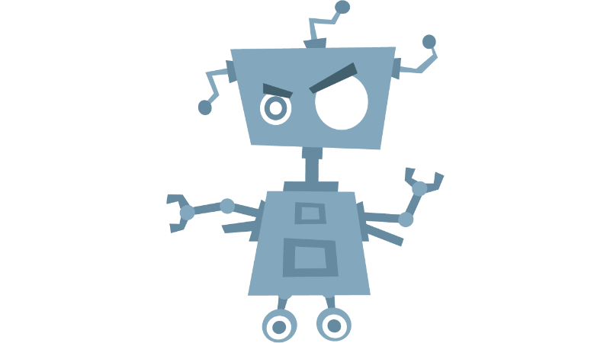


Rise of Data Integration and Decision Making in Apps
Notes:
Data = Insights = Business Value
Insights are Perishable.
We have data in our hands; everything we do, every action tells a story. Sometimes opening an app is all you’d have to do, a lot of context specific insights are at your service. Take Uber app for example - who here use Uber/Lyft like services? (almost everyone)
Likewise, every enterprise have plenty of data both from internal and external sources. They want to take advantage of it; it is the new OIL as some say it.

Slide 6


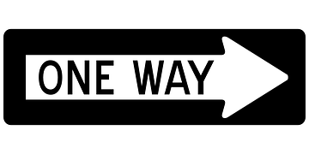
Data Integration Challenges
Flow of data largely
one way - from
transaction systems
to data warehouse
Traditional tools too
slow and rigid to
support changing
data flow patterns
supports legacy apps,
not modern, cloud-native
applications
Notes:
However, in order for such perishable insights to work in our favor and in a timely manner (because, context is important - what’s the point if the Uber App wrong data/map/drive-info?), we would have to get around the current set of challenges.
Let’s review some of the data integration challenges at a high-level.
Legacy ETL/ELT pipelines give ways to linear data processing;
Traditional ETL tooling are slow and often don’t allow new and dynamic data patterns;
Legacy data integration workloads are not easy to modernize and/or port to cloud-native style architectures

Slide 7




Organizational Silos
App Dev
Data Engineering
Data Science
A system’s design is a copy of the organization’s communication structure
— M. Conway
Notes:
As for the organization challenges,
In an enterprise, we see silos. The data organization is disconnected from modern/cloud-native teams at the enterprise.
The tooling, best practices, and the software development processes are significantly different. It is different because of the serviceability and roadmap are different.
Often times, the tooling and practices followed by the data organization doesn’t give room to rapid iterations to deliver quicker value to the business.
From Adrian C.: It’s common to talk about “people, process and technology” when we look at changes in IT.
From Adrian C.: As an analogy, think how long it would take to make a model house starting with a ball of clay, compared to a pile of Lego bricks
https://medium.com/@adrianco/evolution-of-business-logic-from-monoliths-through-microservices-to-functions-ff464b95a44d#.xuureb21w

Slide 8

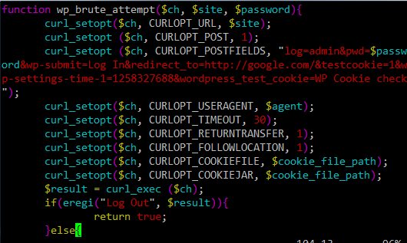
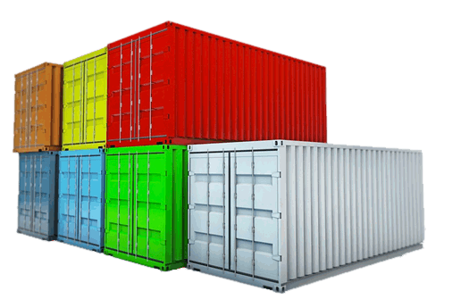
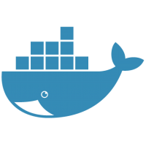

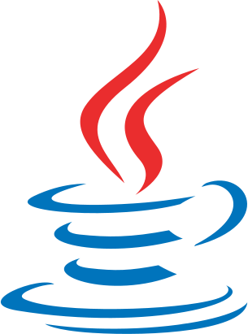

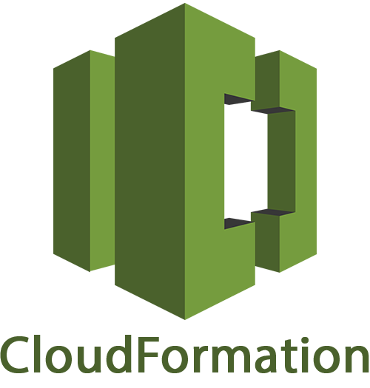
Data Pipelines in Reality
batch processing
predictive analytics
etl
stream processing
data integration
Notes:
As a last broad type of challenge,
When an enterprise decides to build their own set of tooling and stack, it is not pretty.
Standards, expectations and proven ideas are once again being reinvented - why?
The teams tend to pickup tools as a tactical measure and it ends up being used in the production and because of that, they end up maintaining it like forever.
Given the varying requirements within the enterprise, it gets forked a few times, too. More fragmentation overall!

Slide 9

Notes:
OK, so that’s some of the general set of challenges that we reviewed so far. Now that you’re aware of the problem space, let’s dive into solving them. Let’s go!
We are going to assume you’ve enough background about microservices.

Slide 10


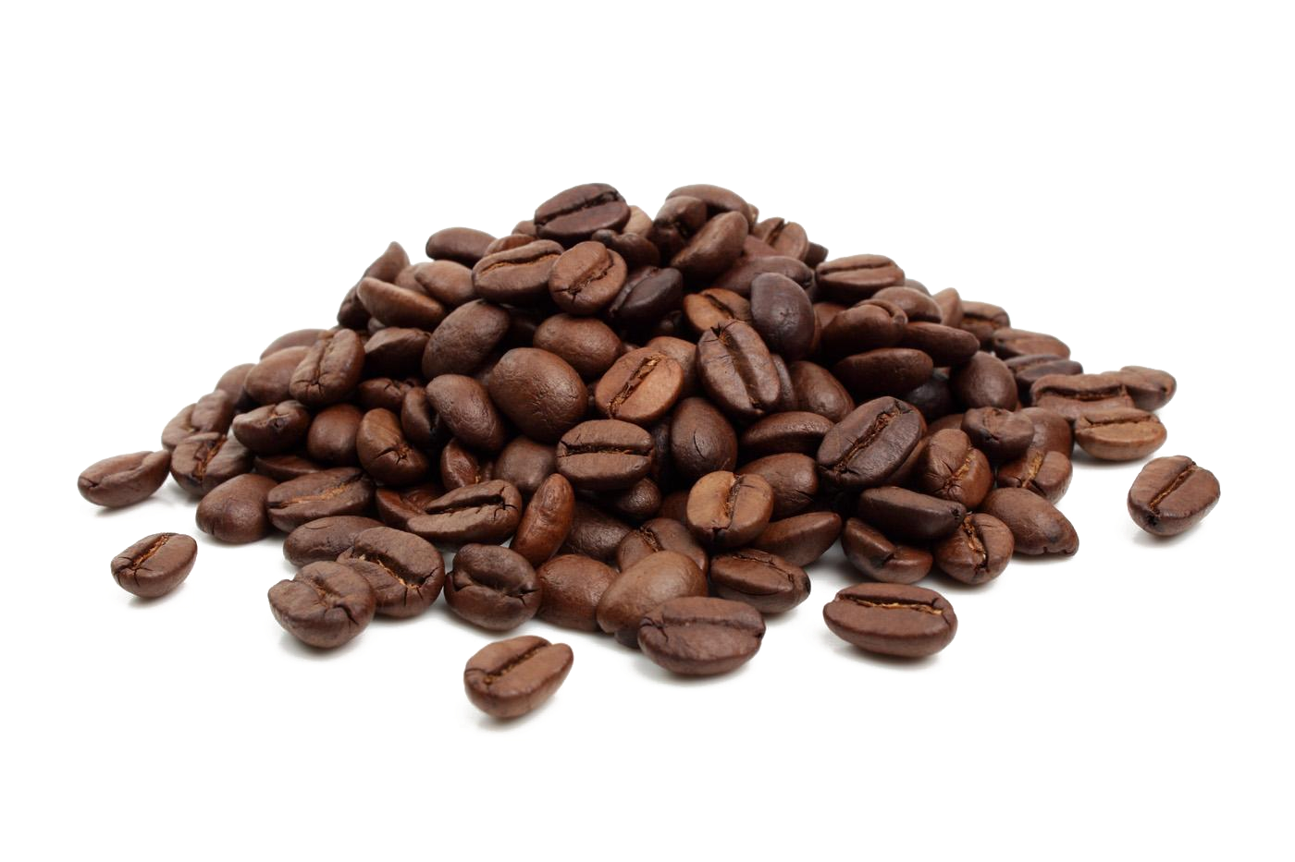
Microservices Turn Out to be
Great for Data Processing
Developing cloud-native applications provide:
continuous delivery
higher reuse
scalability and resilience

Slide 11



Spring Boot
AutoConfigure
Security
Dev-Tools
Actuator
CLI
Starters
Logging
Health Checks
~10+M Downloads / Month
Notes:
Create standalone production grade spring applications that just “runs”!
Auto configure Spring where possible.
Don’t worry about boilerplate configurations; let Spring handle it for you; focus on the business logic instead.

Slide 12

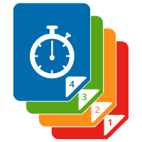

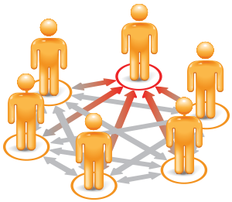


Emerging Challenges
Service Discovery
Versioning
Fault Tolerance
Coordination
Load Balancing
Routing
Notes:
Microservices is no free-lunch; there are challenges, in fact, the distributed systems challenges are pretty significant.

Slide 13





Spring Cloud
Hystrix
Eureka
Ribbon
Zuul
Feign
Service Discovery
Config Server
Control Bus
Config Server
Zookeeper
Distributed Tracing
Notes:
Here comes Spring Cloud! Takes the distributed systems challenges head-on!

Slide 14
Spring Cloud
Service Discovery
Eureka, Consul
Versioning
Eureka, Config Server
Fault Tolerance
Hysterix
Coordination
ZooKeeper
Load Balancing
Ribbon
Routing
Zuul
Notes:
Microservices is no free-lunch; there are challenges, in fact, the distributed systems challenges are pretty significant.

Slide 15

Spring Cloud Data Flow
DSL/Shell
REST-API/Dashboard
Flo Visual Designer
Spring Cloud Stream
Spring Cloud Task
Spring Integration
Spring Boot
Spring Batch
Notes:
Spring Cloud Data Flow is built from the group up with microservice architecture in mind. The product is made up of several microservice projects and sub-modules. This picture highlights the top-level projects alone and we will cover all of them today.
You’ll see this visual a few times today. This is a running roadmap for this workshop. Based on the topic we are to cover, we will see color-coded boxes in this visual - you will get an idea what we are cover.

Slide 16

Spring Cloud Data Flow
DSL/Shell
REST-API/Dashboard
Flo Visual Designer
Spring Cloud Stream
Spring Cloud Task
Spring Integration
Spring Boot
Spring Batch
Notes:
This is an example.
Now, we are going to introduce you all to SCDF and the top-level projects it builds on.

Slide 17




Data Architecture
Stream
Batch
longer running
services
short lived
processes

Slide 18


Streaming = Long Running
Spring Integration
enables lightweight messaging within Spring-based applications and supports integration with external systems
Spring Cloud Stream
enables you to create powerful event-driven streaming data applications with a minimal amount of coding
Notes:
In Spring’s portfolio, we have have had Spring Integration (SI) for about 9+ yrs in production. This project allows you to connect to external system such as file-systems, messaging middlewares, hadoop, sql-no-sql stories, etc.
To further simplify developing integration applications with SI at its foundation, Spring Cloud Stream project was spun-out. Apart from SI, this project also builds upon Spring Boot and Spring Cloud patterns and best practices, too.
In 1-line, SCSt provides event-driven microservices framework, so you can quickly build standalone production grade streaming applications. You’re developing a well-known and familiar Spring Boot applications at the end of the day.

Slide 19
Task = Short Lived
Spring Batch
enables the development
of robust batch applications vital for the daily operations of enterprise systems
Spring Cloud Task
enables you to develop and run short-lived executable data applications locally or in the cloud
Notes:
We have seem streaming solutions, but there’s batch/task based workloads that is equally important in enterprise setting.
In Spring’s portfolio, we have have had Spring Batch (SB) for about 9+ yrs in production. This project allows you to build batch applications rapidly.
To further simplify developing batch applications with SB at its foundation, Spring Cloud Task as project was spun-out. Apart from SB, this project also builds upon Spring Boot and Spring Cloud patterns and best practices, too.
In 1-line, SCT provides short-lived microservices framework, so you can quickly build standalone production grade task applications. They are short-lived because the application runs and it is live only as far as the business logic embedded in it is operational. Again, Spring Boot applications all the way.

Slide 20





Spring Cloud Data Flow is
an orchestration service for composable
microservice applications on modern runtimes
Stream Processing
Batch Processing
Powered by: Spring Cloud Stream
Powered by: Spring Cloud Task
task create foobar --definition
“foo &&
< bar && baz || jaz >
&& bye”
foo
stream create foo --definition "http | transform | cassandra"
bar
jaz
transform
baz
bye
http
cassandra
Notes:
You can build production grade SCSt and SCT applications as standalone stack; however, once you have a several of them and you’d need an easy to orchestrate and operationalize them in in the wild.
That’s where Spring Cloud Data Flow comes in.
We call it: “a orchestration service for composable microservice applications on modern runtimes”
Let’s review SCSt and SCT in the context of SCDF.

Slide 21

Spring Boot
Spring Cloud
Spring Cloud Stream
Spring Cloud Task
Spring Cloud Data Flow
Notes:
You can build production grade SCSt and SCT applications as standalone stack; however, once you have a several of them and you’d need an easy to orchestrate and operationalize them in in the wild.
That’s where Spring Cloud Data Flow comes in.
We call it: “a orchestration service for composable microservice applications on modern runtimes”
Let’s review SCSt and SCT in the context of SCDF.

Slide 22
Demo: Twitter Analytics

Slide 23





Runtime Abstraction
}
}
Core
Community
Notes:
SCDF builds an abstraction that’s easy to extend. We are not too opinionated. You have options to operationalize SCDF in variety of runtimes.

Slide 24

Data Pipelines in Reality
batch processing
predictive analytics
etl
stream processing
data integration
Notes:
Let’s revisit the challenges that we reviewed in the beginning.
You don’t have to fire-fight the operational requirements constantly; why do you need to build your homegrown data pipeline solution when you have several options?
There’s no tool that fits all the requirements.
Instead of choosing a technology or building your own stack, please embrace the ones that matter for your business.

Slide 25





Data Pipelines in Reality
Notes:
Do you want to be in fire-fight mode constantly or you’d prefer being more productive and focus on business values that matter to your customers and of course your organization?

Slide 26
Repeatable Process
Spring Boot Apps
Consistent Dev, Testing, and CI Tooling
Extensible Abstractions
Declarative DSL and Pipelines
Drag & Drop GUI and Pipelines
REST-APIs and Rapid Dashboarding
Unified Stream and Batch Processing
Notes:
“Simple things should be simple; complex things should be possible”

Slide 27
Consistency
App Dev |
Data Engineering
| Data Science
Notes:
Spring, Spring Boot and SCDF offer consistent set of tools, patterns, and best practices. Silos could meltdown to form a more coherent experience across the all the teams.

Slide 28
Appendix

Slide 29

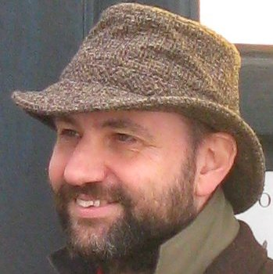
Microservices
a single application as a suite of small services,
each running in its own process
and communicating with lightweight mechanisms,
often an HTTP resource API
James Lewis and Martin Fowler
ThoughtWorks

Slide 30
Microservices
a single application as a suite of small services,
each running in its own process and
communicating with lightweight
mechanisms, often an an
HTTP resource API

